Slide 1
RAILWAY RESERVATION SYSTEM

Slide 2
UML DIAGRAMS

Slide 3
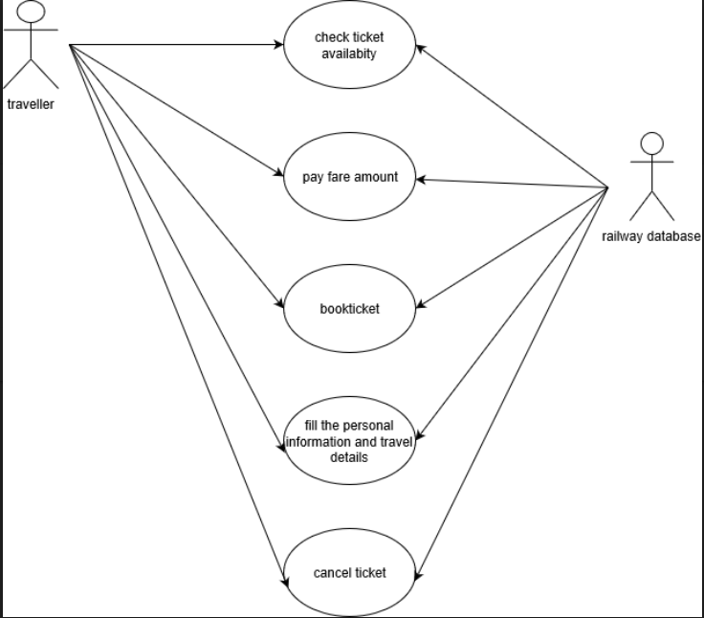
USE CASE DIAGRAM

Slide 4
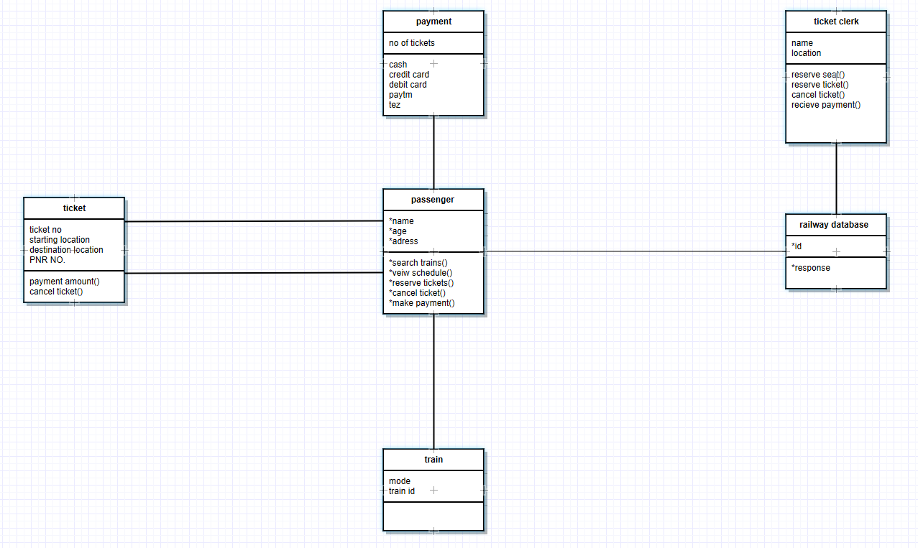
CLASS DIAGRAMS

Slide 5
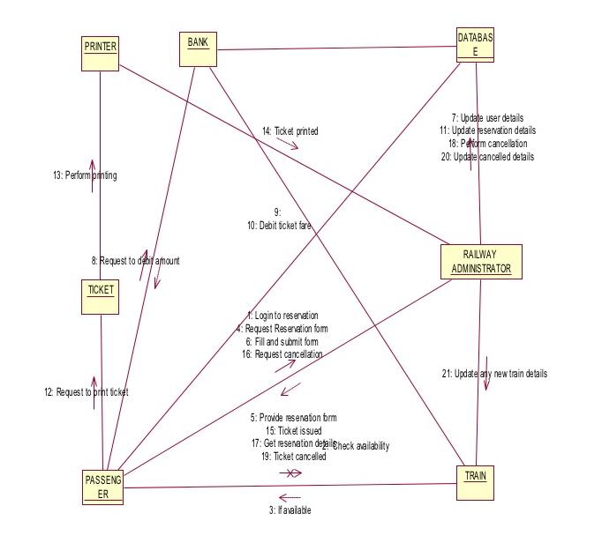
COLLABORATION DIAGRAM

Slide 6
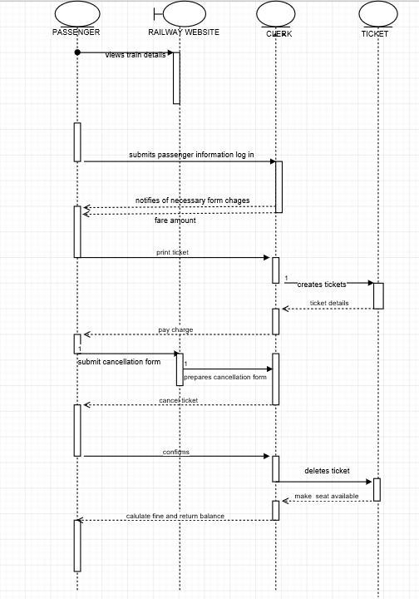
SEQUENTIAL DIAGRAM

Slide 7
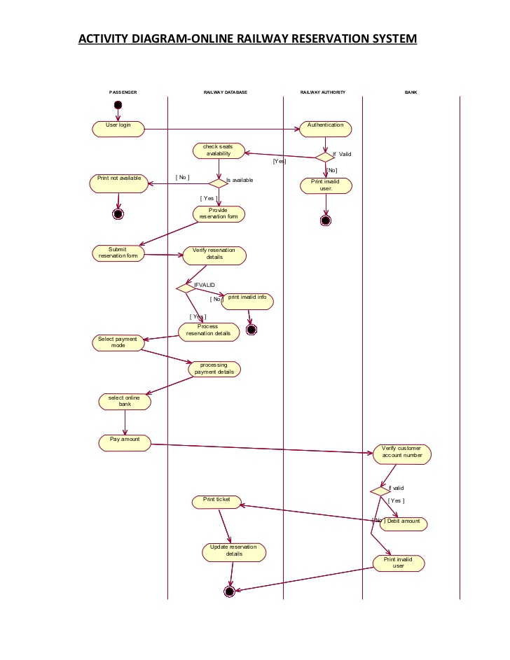
ACTIVITY DIAGRAM

Slide 8
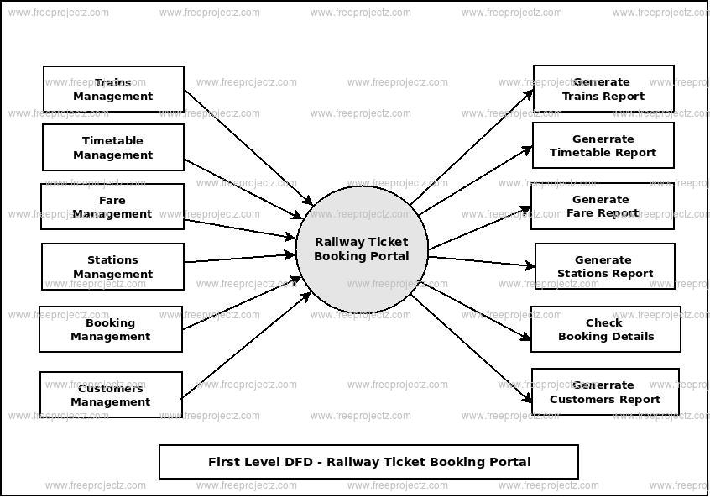
DATA FLOW DIAGRAMS

Slide 9
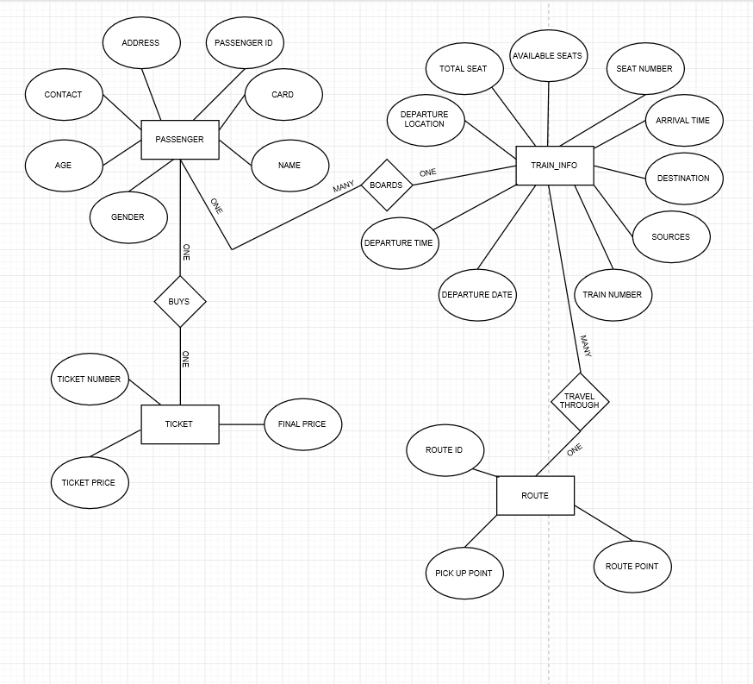
GENERAL BLOCK DIAGRAM

Slide 10
THANK YOU

